Slide 1
STL Decomposition
Renato R. Maaliw III, DIT
College of Engineering
Southern Luzon State University
Lucban, Quezon, Philippines

Slide 2
STL
Seasonal-Trend Decomposition using LOESS
Uses locally weighted regression for smoothing
Allows flexible seasonality adjustments

Slide 3
STL
Better than traditional methods (like ETS)
It can handle changing seasonality
Robust to outliers

Slide 4
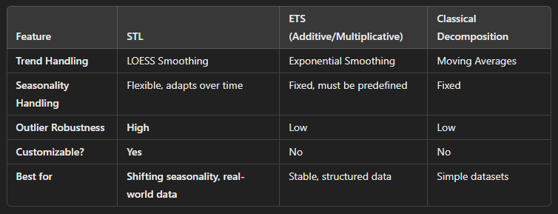

Slide 5
Key Benefits of STL
Handles complex seasonality (climate, traffic)
Works with irregular time series (non-uniform observations
More accurate that traditional methods
Robust to outliers

Slide 6
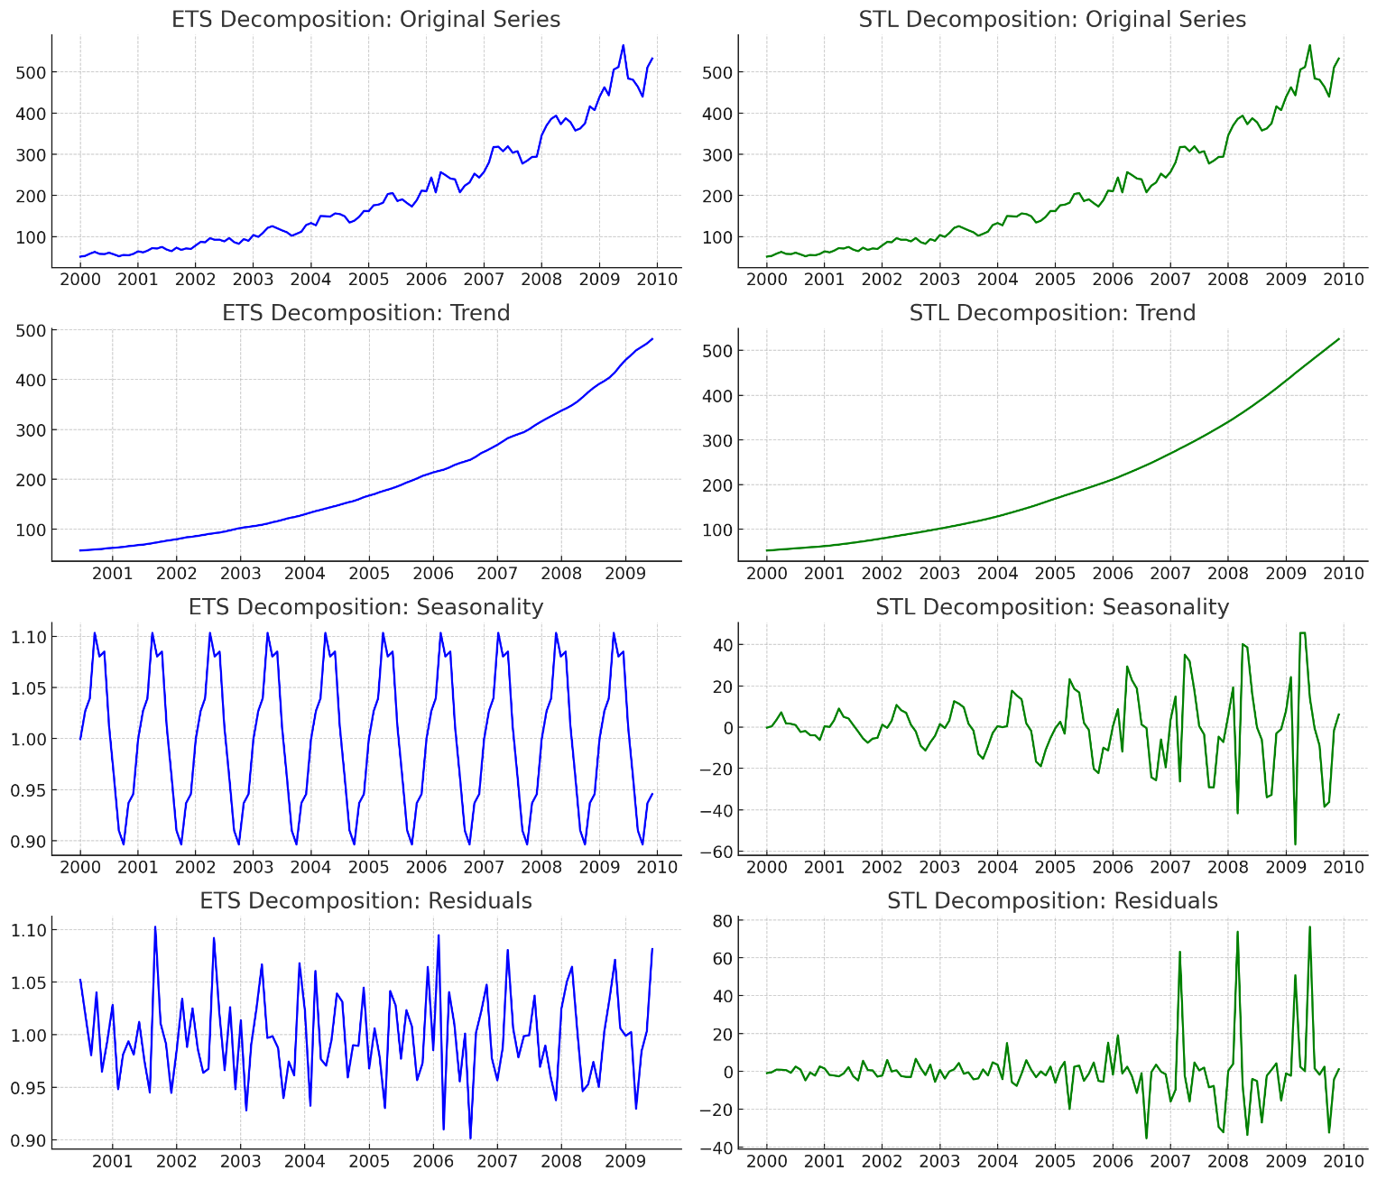
Trend
ETS:
Rigid and smooth
Works well when trend is steady
STL
Flexible, captures variations better
Can detect local trend shifts that ETS might smooth out too aggressively
* If you need smooth forecast, ETS is better. If your trend changes over time, STL is better *

Slide 7
Seasonality
ETS:
Seasonality is fixed, it assumes same seasonal pattern throughout.
If seasonality changes over time, ETS might not capture it well.
STL
Seasonality is more flexible & adjusts slightly over time.
Allows for shifting seasonal effects, making it better for handling seasonality changes
* If seasonality remains constant, ETS is good. If seasonality shifts over time, STL is better *

Slide 8
Residual
ETS:
More structured, it might not fully capture some variations.
This could lead to autocorrelated residuals, which is not ideal.
STL
The residuals look more random, meaning it has done a better job of extracting trend and seasonality, making it robust to outliers.
* If your data has sudden changes or outliers, STL is better. If your data is stable, ETS is fine.

Slide 9
[Code Demo]

Slide 10
01. One of the key advantage of STL decomposition is its flexibility. Which feature illustrates this?
A. It requires specifying only one smoothing parameter for the entire series
B. It produces forecasts that are more accurate than ETS models 100% of the time
C. It allows seasonal component to change by using locally weighted smoothing
D. It can handle any type of seasonality automatically without user inpute

Slide 11
01. One of the key advantage of STL decomposition is its flexibility. Which feature illustrates this?
A. It requires specifying only one smoothing parameter for the entire series
B. It produces forecasts that are more accurate than ETS models 100% of the time
C. It allows seasonal component to change by using locally weighted smoothing
D. It can handle any type of seasonality automatically without user inpute

Slide 12
Thank you very much for listening.

